Slide 1
2244 Arçelik-ODTU Industrial Servo Drive – Autotuning
03.04.2020 Online meeting
Review Article - Setup

Slide 2
Previously on meetings
Literature review
Model
Some specific articles
Excitation based algorithms

Slide 3
Project Map
Literature
Problem
Building Model
Building Test Bench
Evaluating prior art solutions
Trails
Thesis

Slide 4
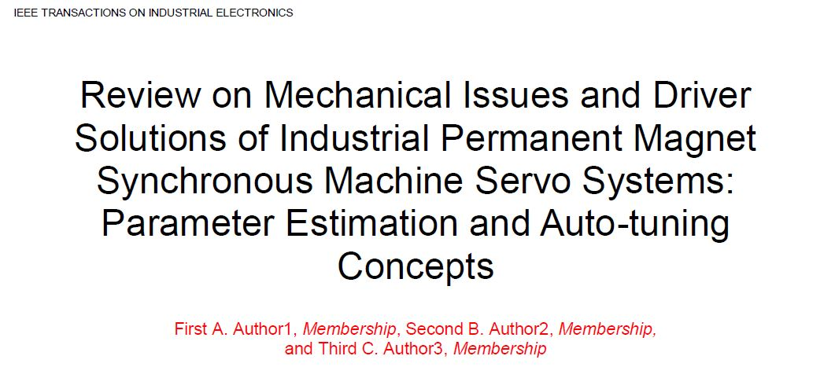
Review Article

Slide 5
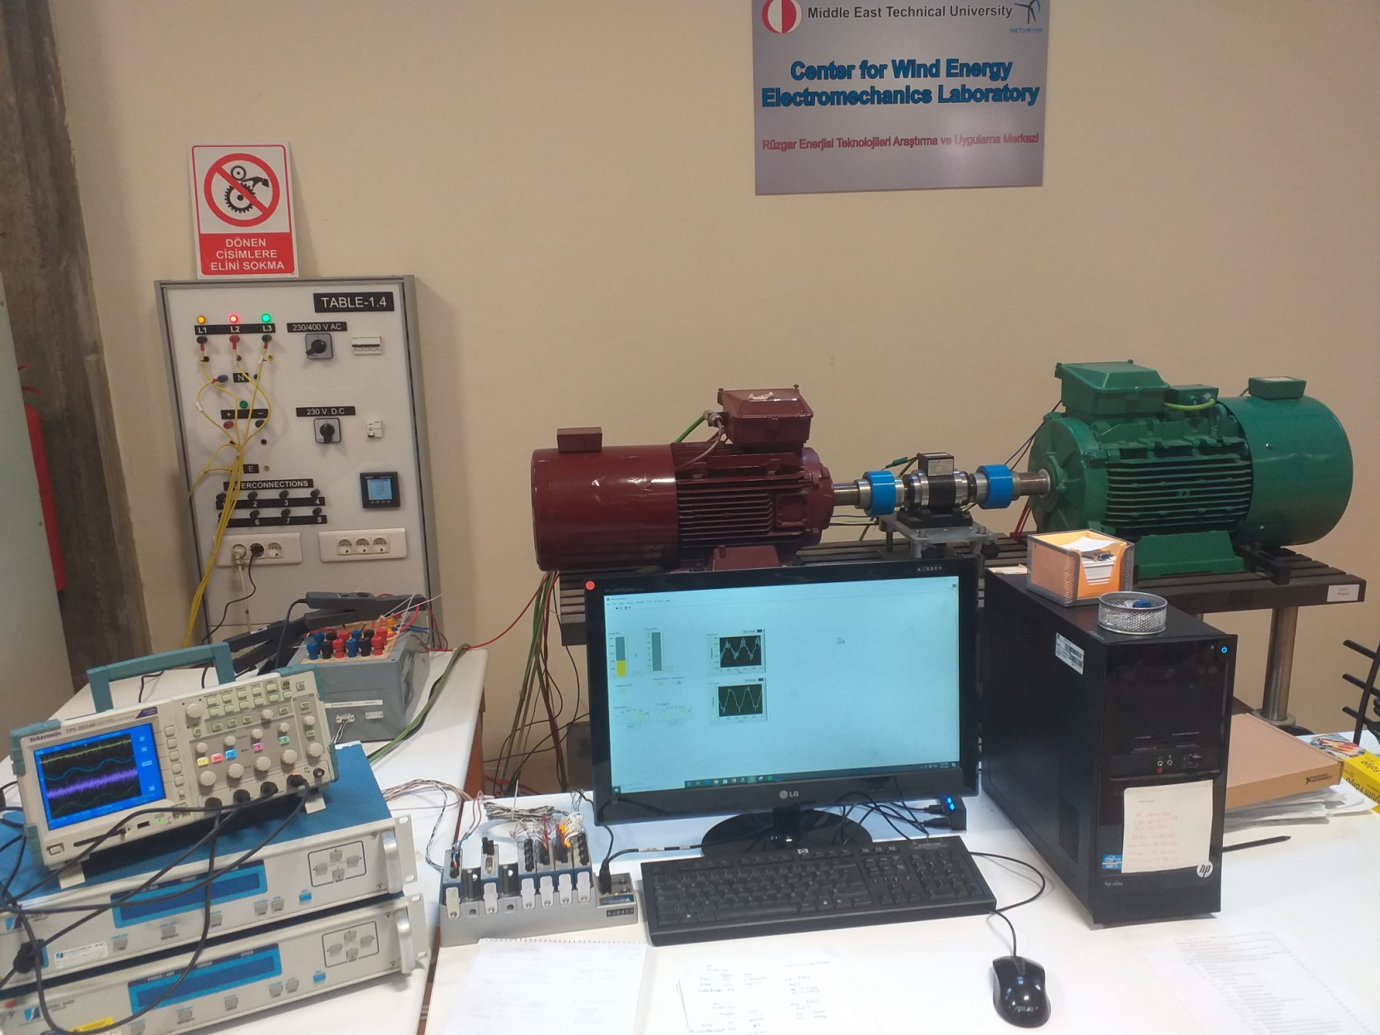
Experimental Setup - RÜZGEM
IM Torque mode
Open loop
PM SG Speed mode
Switching
Labview

Slide 6
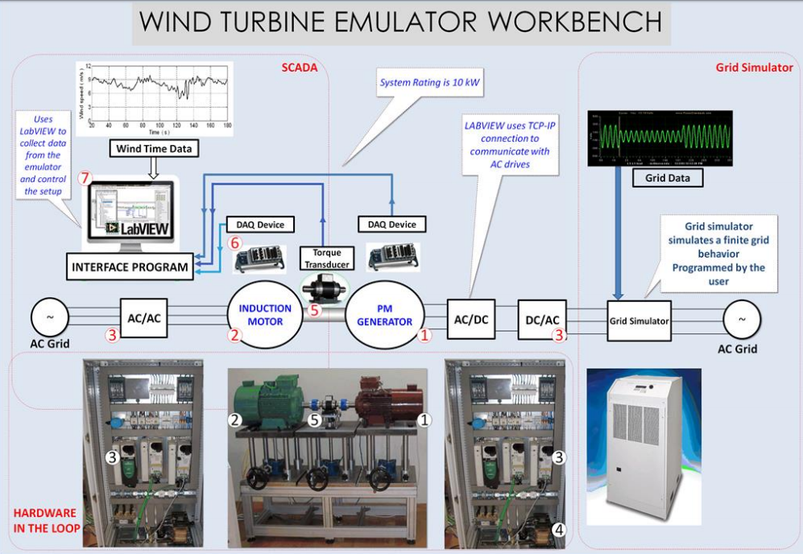

Slide 7
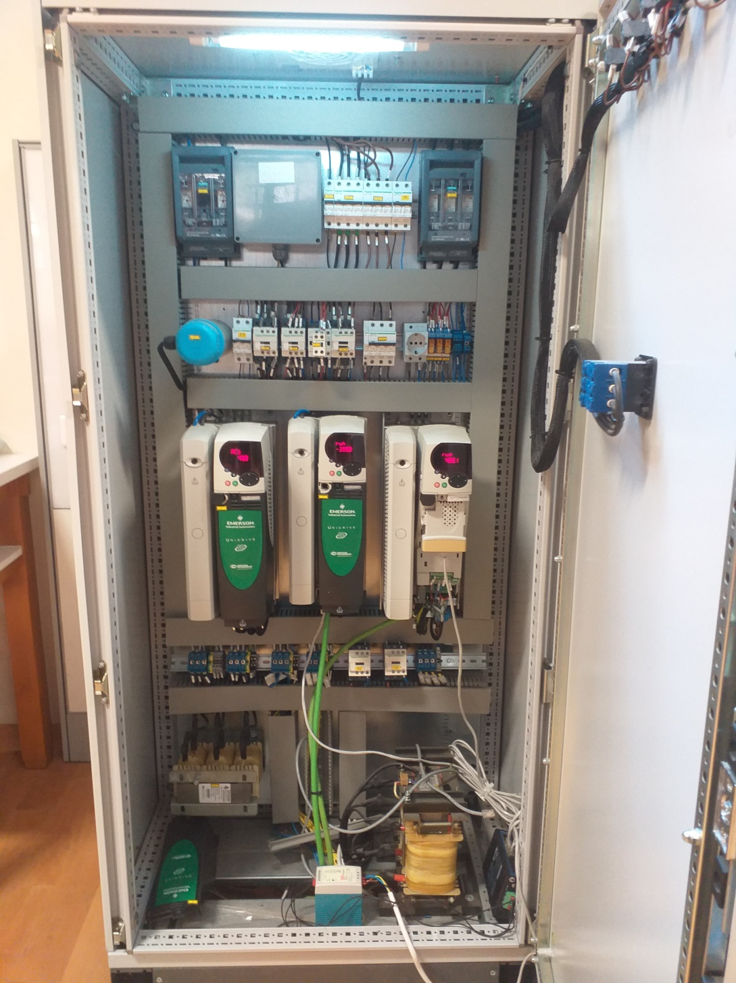
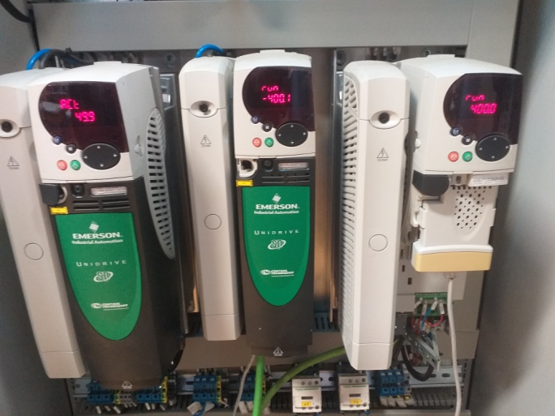


Slide 8
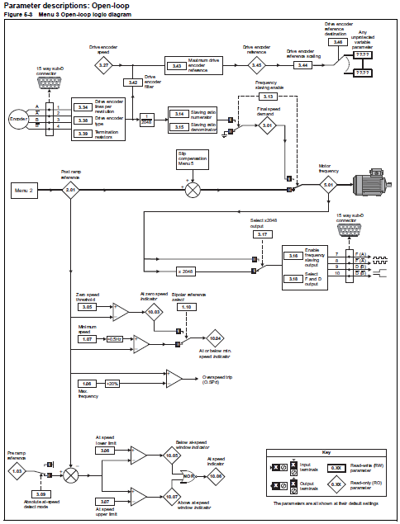

Slide 9
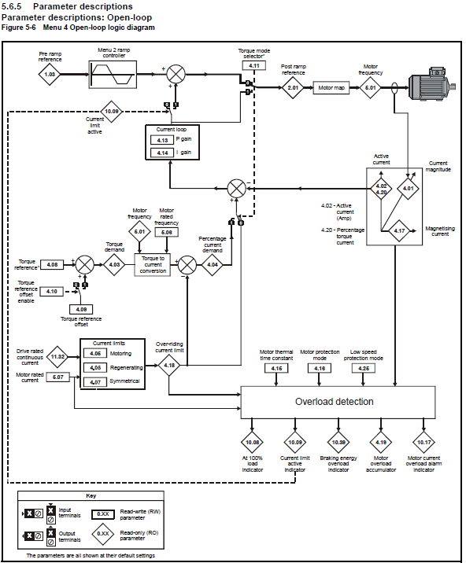

Slide 10
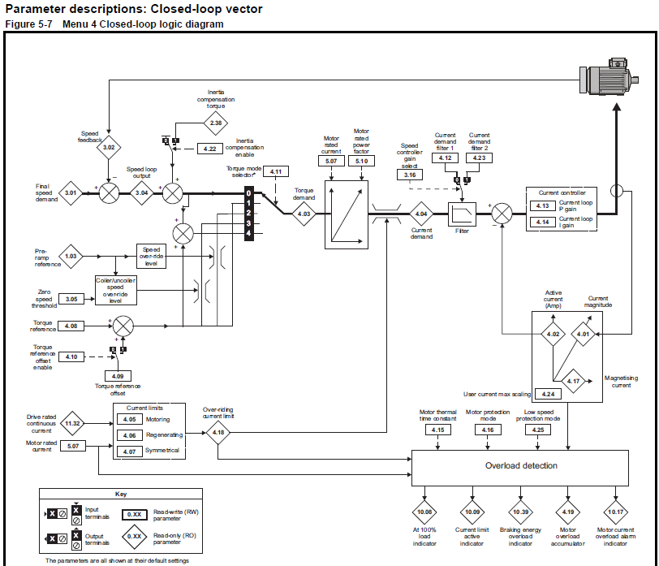

Slide 11
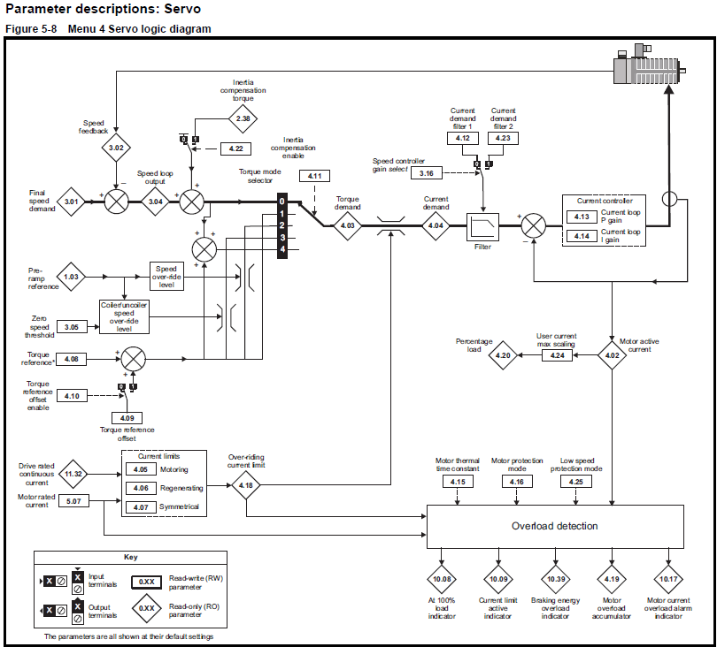

Slide 12
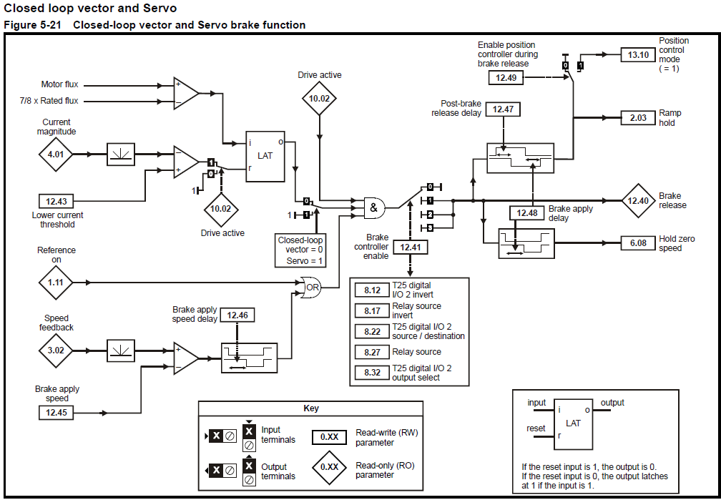

Slide 13
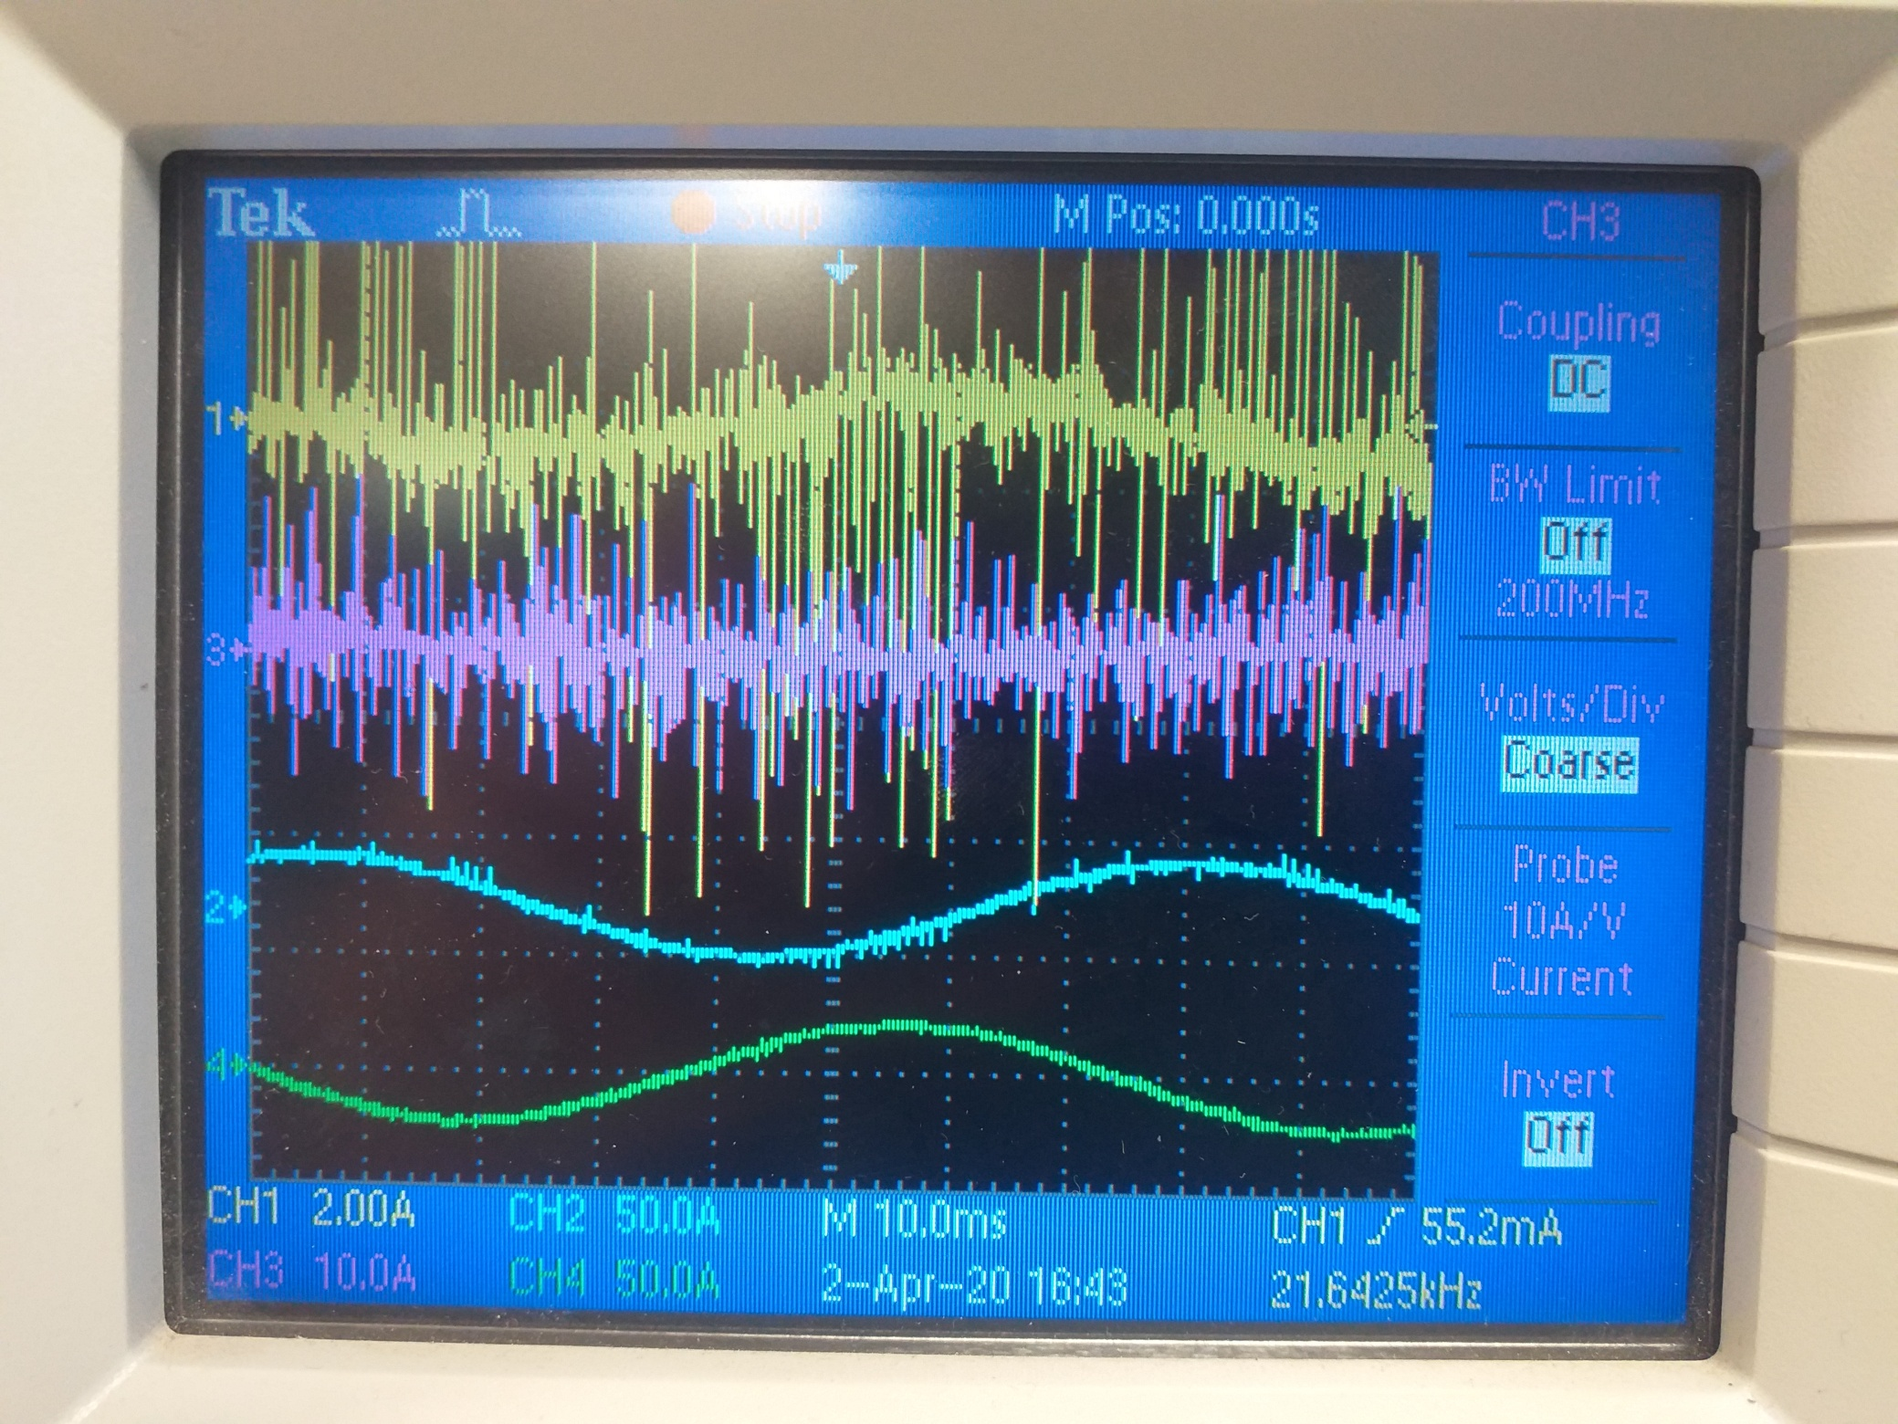

Slide 14
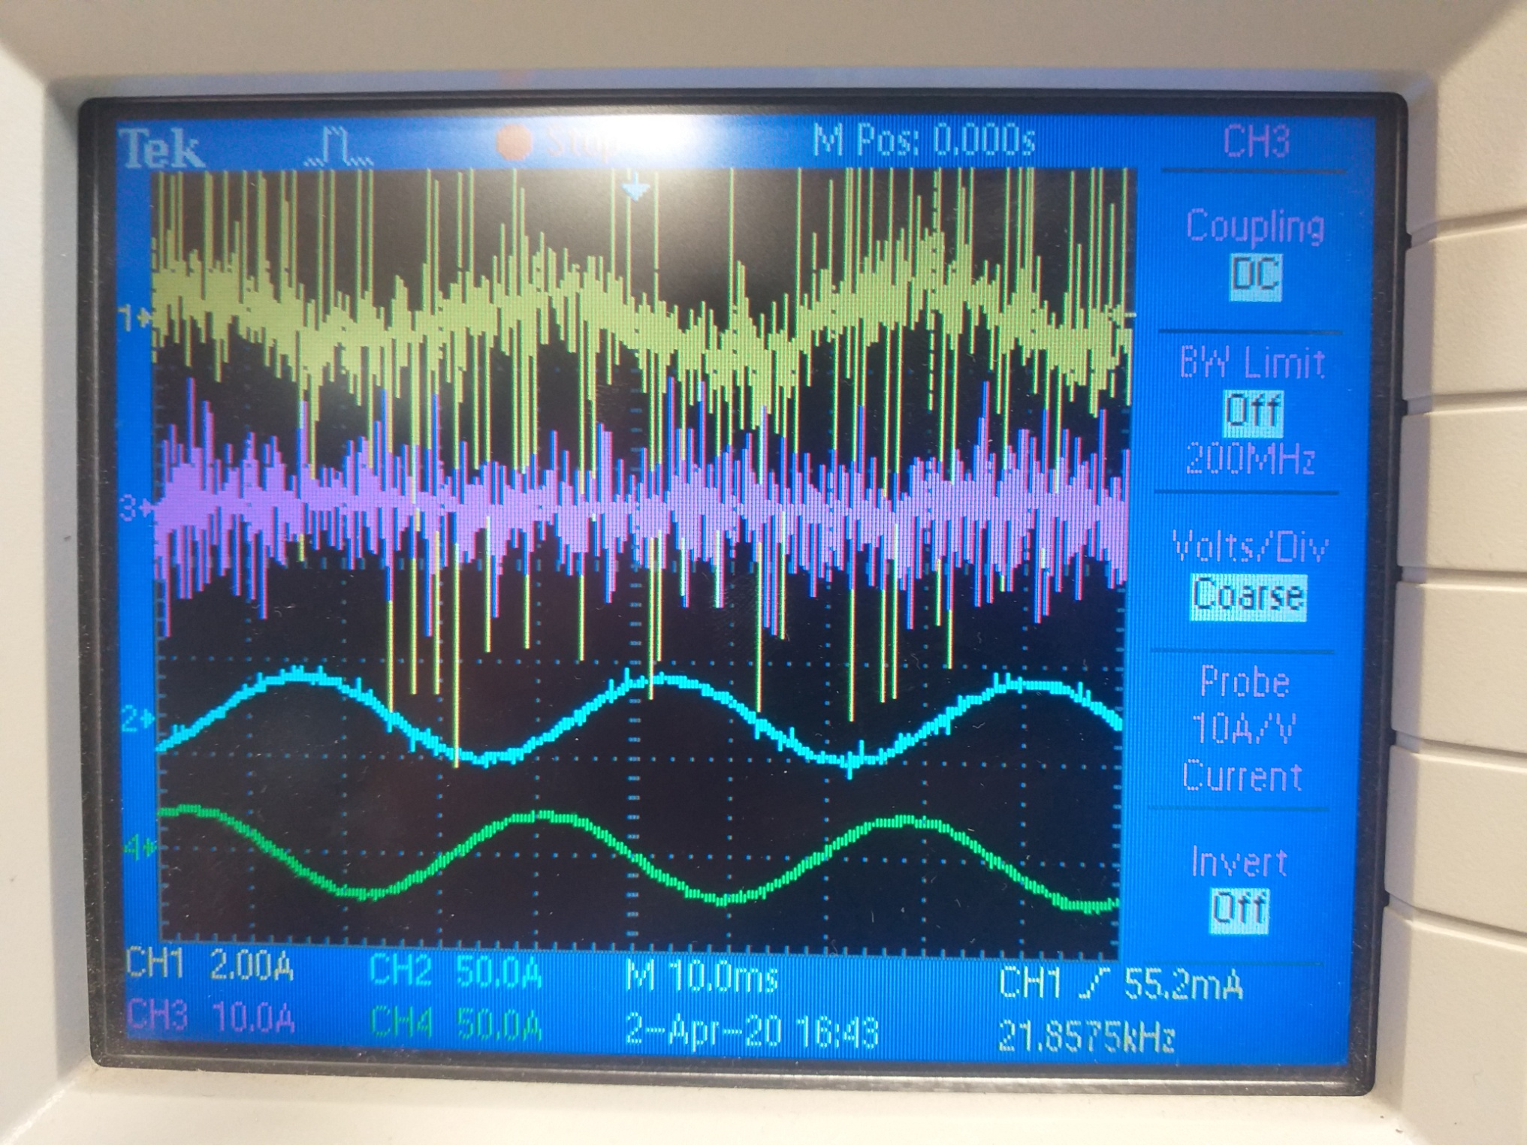

Slide 15
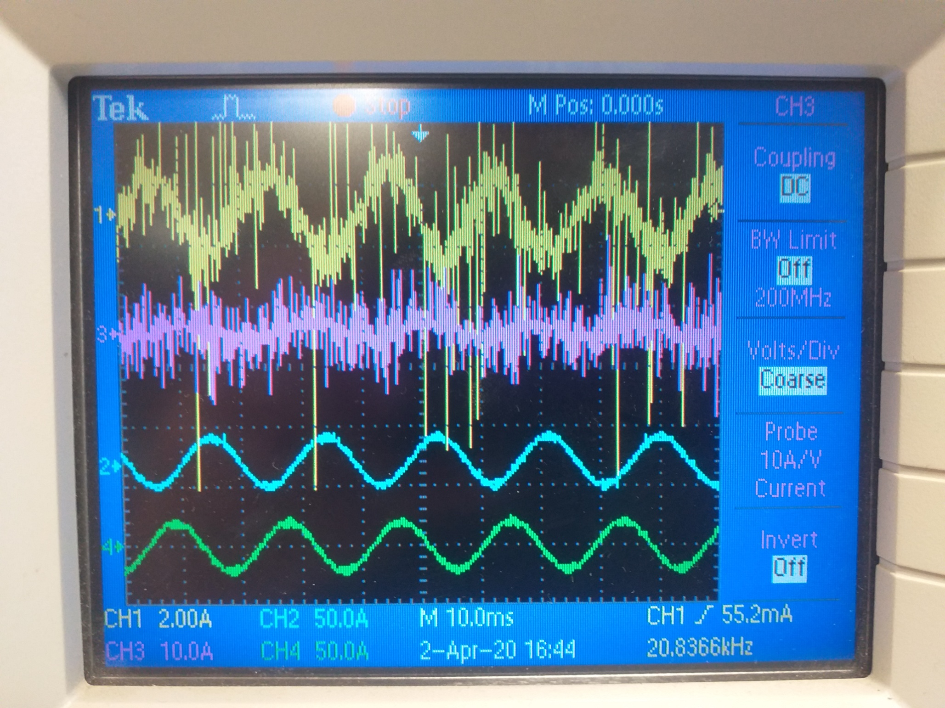

Slide 16
Next issues
Filter Model, Mathematics
Biquad Filter implementation as NOTCH

